Slide 1
Sensor Technology
By Rahul Shrivastava

Slide 2
Sensor Technology
A sensor is a device that detects and responds to some type of input from the physical environment.
The specific input could be light, heat, motion, moisture, pressure, or any one of a great number of other environmental phenomena. The output is generally a signal that is converted to human-readable display at the sensor location or transmitted electronically over a network for reading or further processing.
Here are a few examples of the many different types of sensors:
In a mercury-based glass thermometer, the input is temperature. The liquid contained expands and contracts in response, causing the level to be higher or lower on the marked gauge, which is human- readable.
An oxygen sensor in a car's emission control system detects the gasoline/oxygen ratio, usually through a chemical reaction that generates a voltage. A computer in the engine reads the voltage and, if the mixture is not optimal, readjusts the balance.
Motion sensors in various systems including home security lights, automatic doors and bathroom fixtures typically send out some type of energy, such as microwaves, ultrasonic waves or light beams and detect when the flow of energy is interrupted by something entering its path.
A photo sensor detects the presence of visible light, infrared transmission (IR), and/or ultraviolet (UV) energy.

Slide 3
Sensor
In the broadest definition, a sensor is a device, module, or subsystem whose purpose is to detect events or changes in its environment and send the information to other electronics, frequently a computer processor.
A sensor is always used with other electronics, whether as simple as a light or as complex as a computer.
Notes:
ghyscg

Slide 4
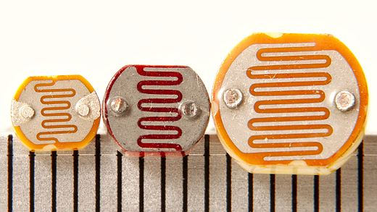
LDR (Light Dependent Resistor)
Notes:
ghyscg

Slide 5
LDR (Light Dependent Resistor)
A photoresistor (or light-dependent resistor, LDR, or photo-conductive cell) is a light-controlled variable resistor.
The resistance of a photoresistor decreases with increasing incident light intensity.
A photoresistor is made of a high resistance semiconductor. In the dark, a photoresistor can have a resistance as high as several megohms (MΩ), while in the light, a photoresistor can have a resistance as low as a few hundred ohms.
Notes:
ghyscg

Slide 6
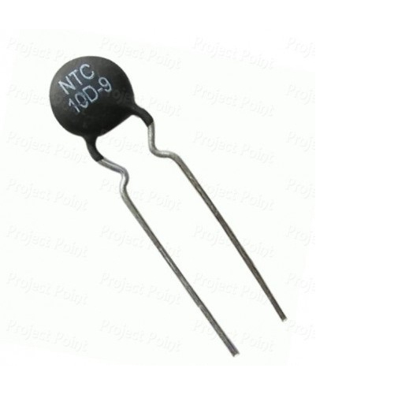
Thermistor
Notes:
ghyscg

Slide 7
Thermistor
A thermistor is a type of resistor whose resistance is dependent on temperature, more so than in standard resistors.
The word is a portmanteau of thermal and resistor.
Thermistors are of two opposite fundamental types:
With NTC (Negative Tempreture Cofficient) thermistors, resistance decreases as temperature rises. An NTC is commonly used as a temperature sensor, or in series with a circuit as an inrush current limiter.
With PTC (Positive Tempreture Cofficient) thermistors, resistance increases as temperature rises. PTC thermistors are commonly installed in series with a circuit, and used to protect against overcurrent conditions, as resettable fuses.
Notes:
ghyscg

Slide 8
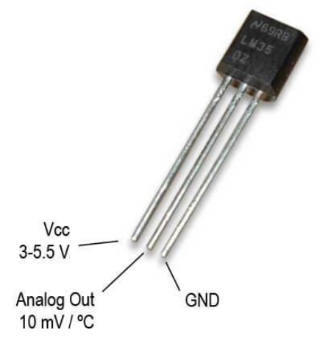
LM35
Notes:
ghyscg

Slide 9
LM35
LM35 is a precision IC temperature sensor with its output proportional to the temperature (in °C).
The operating temperature range is from -55°C to 150°C.
Pin 2 gives an output of 1 millivolt per 0.1°C (10mV per degree).
Notes:
ghyscg

Slide 10
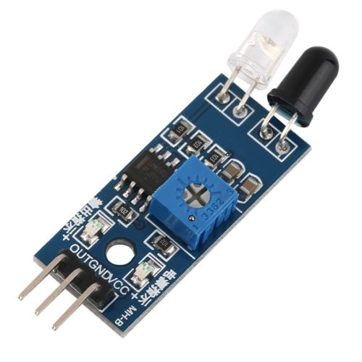
IR Proximity Sensor
Notes:
ghyscg

Slide 11
IR Proximity Sensor
IR stands for Infrared which is a light with wavelength which is not visible to human eyes but cameras can see it.
It is used in many applications such as TV remote and Night-vision cameras.
In a Proximity Sensor an IR LED and a Photodiode is used to find a obstacles . The IR LED transmits light in forward direction when an obstacle is ahead the light reflects and the Photodiode is activated by this method Obstacle is detected.
Notes:
ghyscg

Slide 12
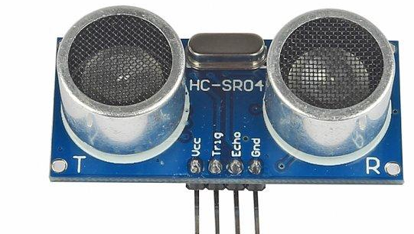
Ultrasonic Sensor
Notes:
ghyscg

Slide 13
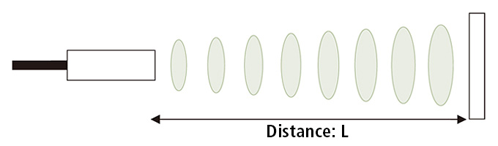
Ultrasonic Sensor
As the name indicates, ultrasonic sensors measure distance by using ultrasonic waves.
The sensor head emits an ultrasonic wave and receives the wave reflected back from the target.
Ultrasonic Sensors measure the distance to the target by measuring the time between the emission and reception.
Notes:
ghyscg

Slide 14
Ultrasonic Sensor Contd…..
The distance can be calculated with the following formula:
Distance L = 1/2 × T × C
where L is the distance, T is the time between the emission and reception, and C is the sonic speed (344m/s at room tempreture). (The value is multiplied by 1/2 because T is the time for go-and-return distance.)
Notes:
ghyscg

Slide 15
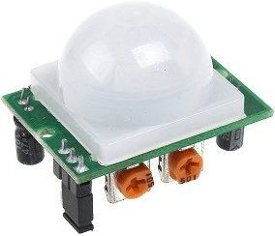
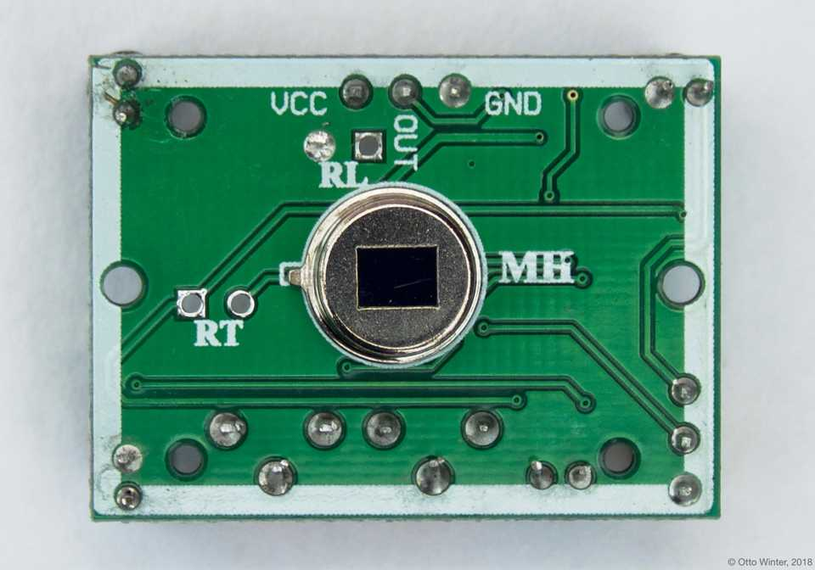
PIR
Notes:
ghyscg

Slide 16
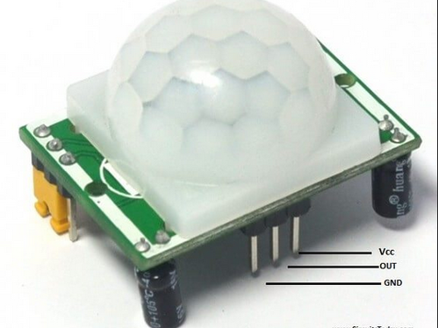
PIR
A passive infrared sensor (PIR sensor) is an electronic sensor that measures infrared(IR) light radiating from objects in its field of view. They are most often used in PIR-based motion detectors.
All objects with a temperature above absolute zero emit heat energy in the form of radiation. Usually this radiation isn't visible to the human eye because it radiates at infrared wavelengths, but it can be detected by electronic devices designed for such a purpose.
At the core of a PIR sensor is a solid state sensor or set of sensors, made from pyroelectric materials—materials which generate energy when exposed to heat.
The detection range can be adjusted with the help of variable resistor.
The duration till the output is HIGH (LOW) can be also be adjusted.
Notes:
ghyscg

Slide 17
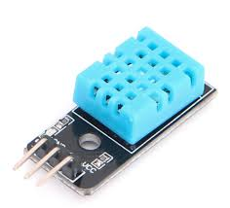
DHT – 11 Humidity & Temperature Sensor
Humidity sensors detect the relative humidity of the immediate environments in which they are placed.
They measure both the moisture and temperature in the air and express relative humidity as a percentage of the ratio of moisture in the air to the maximum amount that can be held in the air at the current temperature.
As air becomes hotter, it holds more moisture, so the relative humidity changes with the temperature.
Notes:
ghyscg

Slide 18
DHT – 11 Humidity & Temperature Sensor Contd….
Humidity sensors use capacitive measurement to determine the amount of moisture in the air.
This type of measurement relies on two electrical conductors with a non-conductive polymer film laying between them to create an electrical field between them. Moisture from the air collects on the film and causes changes in the voltage levels between the two plates.
DHT11 temperature range is from 0 to 50 degrees Celsius with +-2 degrees accuracy.
Notes:
ghyscg

Slide 19
Sensor Technology
The Internet of Things (IoT) couldn’t exist without smart sensors, and the growing use of smart technology is already transforming how manufacturers implement the IoT.
Smart sensors are also bringing more connectivity and analytics to the supply chain. There are some things to know about how and why this is happening.
First, smart sensors are the indispensable enablers of the IoT and the industrial IoT.
Smart sensors, including radio frequency identification (RFID) tags, serve three broad purposes. They identify items, locate them and determine their environmental conditions, all of which have major implications for the supply chain and manufacturing.
Smart sensors are particularly useful in plants or warehouses because they can keep track of temperature and humidity, log data for historical records and quality management, or be used as triggers for alarms or process management.

Slide 20
Sensor Technology
Second, smart sensors impact the supply chain by being embedded in products, which can help improve the manufacturing process or the products themselves.
“sensors can live inside products to create “smart products” and new revenue sources from the enhanced features. They can also permeate the manufacturing process to monitor, control, and improve operations, or be added to logistics to streamline how products are delivered. There are a number of specific purposes of sensors, such as measuring temperature, humidity, vibrations, motion, light, pressure and altitude.

Slide 21
Sensor Technology
Third, the lower costs and more advanced capabilities of RFID tags are starting to enable wider and more effective use.
The cost of RFID, which has come down dramatically, is in more than just the tag itself. To determine the true cost per use you have to include the software applications and deployment costs. The combination of lowered costs for tags and improved capabilities means that their value proposition has changed, and represents an opportunity for enterprises to rethink RFID.

Slide 22
Participatory Sensing

Slide 23
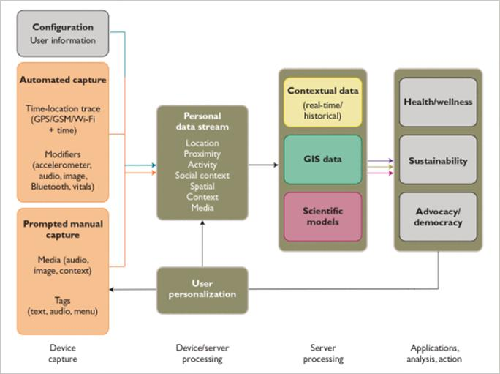
Participatory Sensing
Participatory sensing is the process whereby individuals and communities use ever- more-capable mobile phones and cloud services to collect and analyze systematic data for use in discovery. The convergence of technology and analytical innovation with a citizenry that is increasingly comfortable using mobile phones and online social networking sets the stage for this technology to dramatically impact many aspects of our daily lives.

Slide 24
Participatory Sensing 1. Applications and Usage Models
One application of participatory sensing is as a tool for health and wellness. For example, individuals can self-monitor to observe and adjust their medication, physical activity, nutrition, and interactions. Potential contexts include chronic-disease management and health behavior change. Communities and health professionals can also use participatory approaches to better understand the development and effective treatment of disease.
The same systems can be used as tools for sustainability. For example, individuals and communities can explore their transportation and consumption habits, and corporations can promote more sustainable practices among employees.

Slide 25
Participatory Sensing 2. Essential Components
While empirical data can be collected in a variety of ways, mobile phones are a special and, perhaps, unprecedented tool for the job. These devices have become mobile computing, sensing, and communication platforms, complete with image, audio, video, motion, proximity, and location data capture and broadband communication, and they are capable of being programmed for manual, automatic, and con-text-aware data capture.
Because of the sheer ubiquity of mobile phones and associated communication infrastructure, it is possible to include people of all backgrounds nearly everywhere in the world. Because these devices travel with us, they can help us make sustainable observations on an intimately personal level. Collectively, they provide unmatched coverage in space and time.

Slide 26
Participatory Sensing 2. Essential Components
Leveraged Data Processing and Management
In some cases, the data collected with a mobile device are enough to reveal an interesting pattern on their own. However, when processed through a series of external and cross-user data sources, models, and algorithms, simple data can be used to infer complex phenomena about individuals and groups. Mapping and other interactive capabilities of today's Web enhance the presentation and interpretation of these patterns for participants. Many applications will call for the comparison of current measures to past trends, so robust and long term storage and management of this data is a central requirement.

Slide 27
Industrial IoT (IIOT)

Slide 28
Industrial IoT (IIoT)
The IIoT is part of a larger concept known as the Internet of Things (IoT). The IoT is a network of intelligent computers, devices, and objects that collect and share huge amounts of data. The collected data is sent to a central Cloud-based service where it is aggregated with other data and then shared with end users in a helpful way. The IoT will increase automation in homes, schools, stores, and in many industries.
The application of the IoT to the manufacturing industry is called the IIoT (or Industrial Internet or Industry 4.0). The IIoT will revolutionize manufacturing by enabling the acquisition and accessibility of far greater amounts of data, at far greater speeds, and far more efficiently than before. A number of innovative companies have started to implement the IIoT by leveraging intelligent, connected devices in their factories.

Slide 29
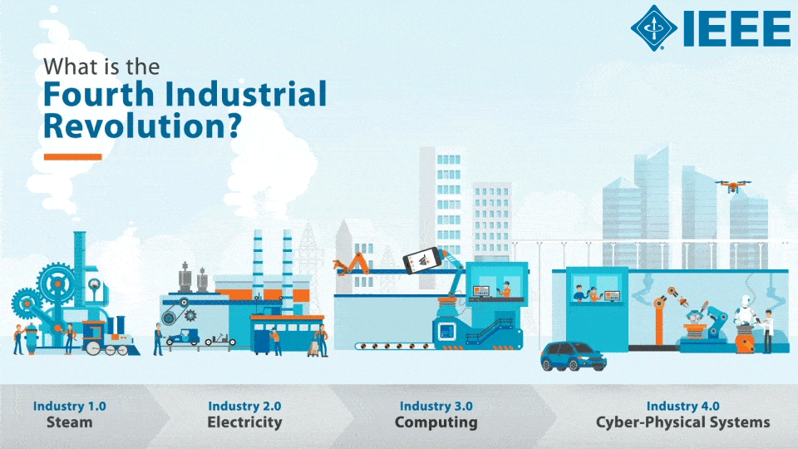

Slide 30
Industrial IoT (IIoT) Benefits
The IIoT can greatly improve connectivity, efficiency, scalability, time savings, and cost savings for industrial organizations.
Companies are already benefitting from the IIoT through cost savings due to predictive maintenance, improved safety, and other operational efficiencies.
IIoT networks of intelligent devices allow industrial organizations to break open data silos and connect all of their people, data, and processes from the factory floor to the executive offices.
Business leaders can use IIoT data to get a full and accurate view of how their enterprise is doing, which will help them make better decisions.

Slide 31
Industrial IoT (IIoT) IIOT Protocols
One of the issues encountered in the transition to the IIoT is the fact that different edge-of-network devices have historically used different protocols for sending and receiving data. While there are a number of different communication protocols currently in use, such as OPC-UA, the Message Queueing Telemetry Transport (MQTT) transfer protocol is quickly emerging as the standard for IIoT, due to its lightweight overhead, publish/subscribe model, and bidirectional capabilities.
hivemq.com/mqtt-essentials/

Slide 32
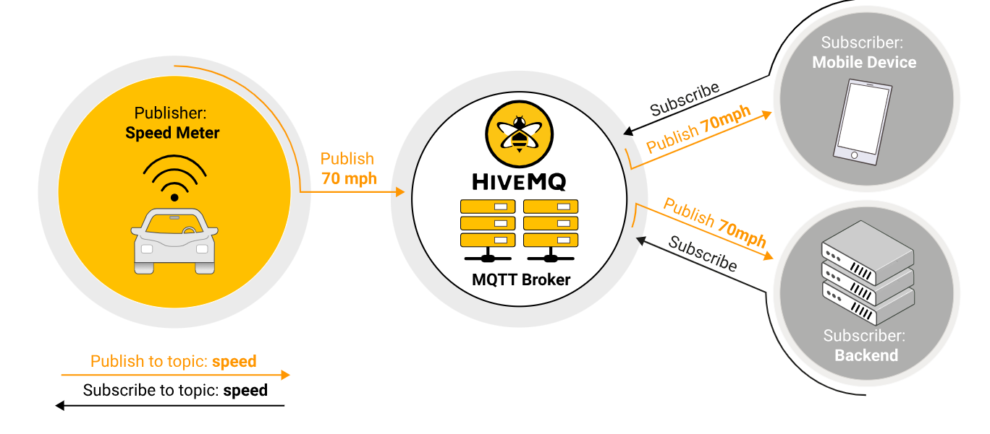

Slide 33
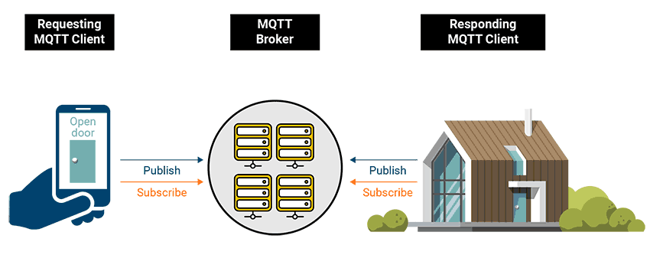

Slide 34
Industrial IoT (IIoT) Challenges of IIOT
Interoperability and security are probably the two biggest challenges surrounding the implementation of IIoT. As technology writer Margaret Rouse observes, “A major concern surrounding the Industrial IoT is interoperability between devices and machines that use different protocols and have different architectures.” Ignition is an excellent solution for this since it is cross-platform and built on open-source, IT-standard technologies.
https://inductiveautomation.com/solutions/iiot
Companies need to know that their data is secure. The proliferation of sensors and other smart, connected devices has resulted in a parallel explosion in security vulnerabilities. This is another factor in the rise of MQTT since it is a very secure IIoT protocol.

Slide 35
Industrial IoT (IIoT) Future of IIOT
The IIoT is widely considered to be one of the primary trends affecting industrial businesses today and in the future. Industries are pushing to modernize systems and equipment to meet new regulations, to keep up with increasing market speed and volatility, and to deal with disruptive technologies. Businesses that have embraced the IIoT have seen significant improvements to safety, efficiency, and profitability, and it is expected that this trend will continue as IIoT technologies are more widely adopted.

Slide 36
Automotive IoT

Slide 37
Automotive IoT
With the number of networked sensors increasing across production, supply chains and products, manufacturers are beginning to tap into a new generation of systems that enables real-time, automatic interactions among machines, systems, assets and things.

Slide 38
Automotive IoT functions provided by Automotive IOT
Ability to view the status of the Assets at anytime, Anywhere & Faster service response from dealer.
By hooking equipment into the IoT, original equipment manufacturers (OEMs) or dealers could use that stream of data to adjust preventative maintenance schedules based on actual wear and be able to better optimize uptime
Enhance equipment and process diagnostics capabilities
Faster Response time and less operations cost for machine configuration requests that could be services remotely

Slide 39
Automotive IoT functions provided by Automotive IOT
Ability to view the entire population of connected products together marketing data and product trends
Real-time remote monitoring of performance
Multi site monitoring improving the operational efficiency and reducing the site downtime
Predictive Maintenance and quality

Slide 40
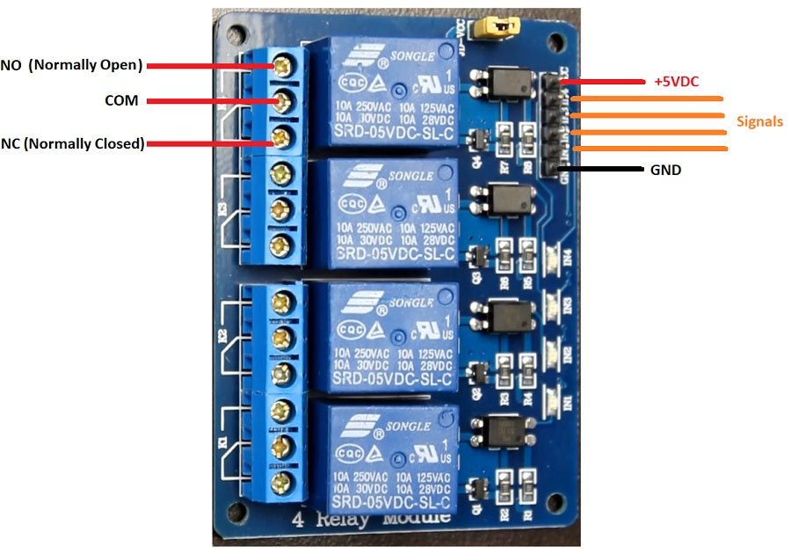
Actuator

Slide 41
Actuators
An actuator is a component of a machine that is responsible for moving and controlling a mechanism or system, for example by opening a (valve). In simple terms, it is a "mover".
An actuator requires a control signal and a source of energy.
The control signal is relatively low energy and may be electric voltage or current, pneumatic or hydraulic pressure, or even human power.
Its main energy source may be an electric current, hydraulic fluid pressure, or pneumatic pressure. When it receives a control signal, an actuator responds by converting the signal's energy into mechanical motion.
Notes:
ghyscg

Slide 42
Need of Actuator
Processing Unit (microcontrollers)
Temperature / Humidity / Pressure / Color / Motion
Sensors
Actuators
Control the Environment
Environment (Plant / Air Conditioner / etc.)
Notes:
ghyscg

Slide 43
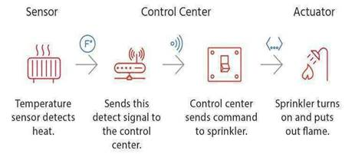
Actuator
In typical IoT systems, a sensor may collect information and route to a control center where a decision is made and a corresponding command is sent back to an actuator in response to that sensed input.

Slide 44
Types
Electrical
Hydraulic
Pneumatic

Slide 45
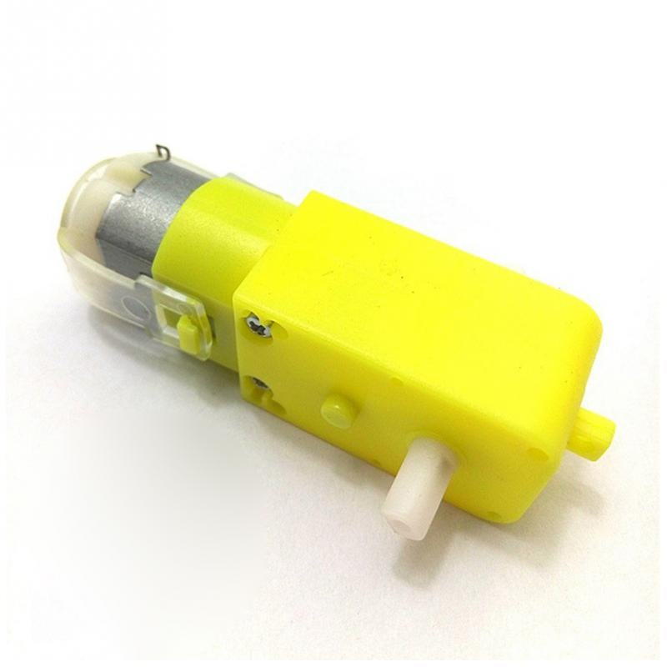
DC Motor
Converts electrical energy into mechanical energy
Direction can be changed by changing polarity
Speed depends on average DC voltage and current
Half bridge circuits like L293D are used to control the direction and speed of motor
Notes:
ghyscg

Slide 47
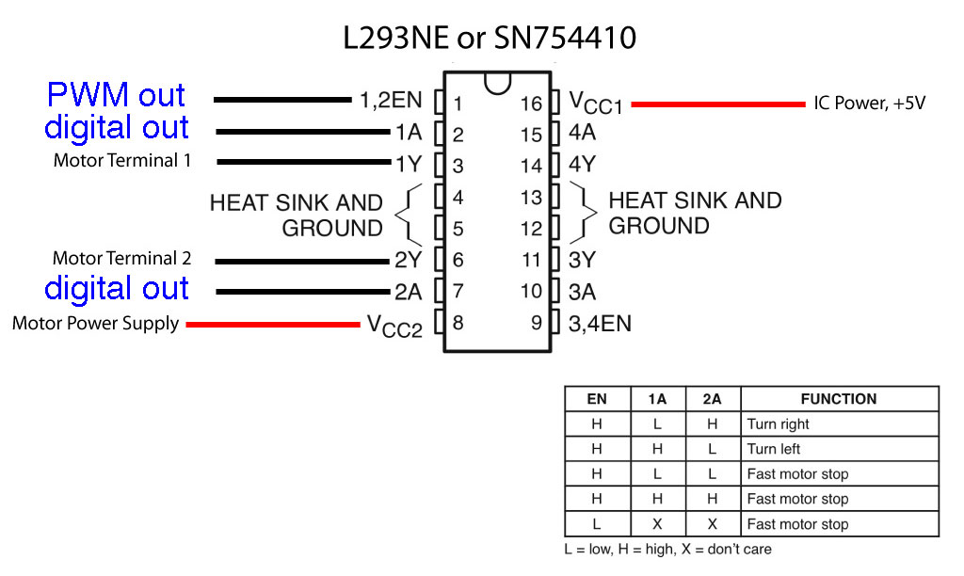
L293D Half Bridge Integrated Circuit
Notes:
ghyscg

Slide 48
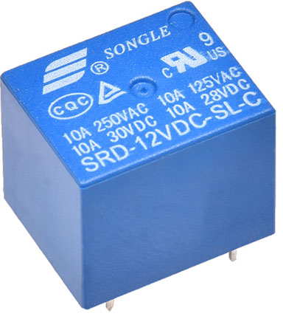
Relay
A relay is a electromagnetic switch.
Its basic function is to allow a low power control voltage operate a high power switch.
The control and the switch are electrically isolated from each other and they have their own voltage and current ratings/requirements.
Notes:
ghyscg

Slide 49
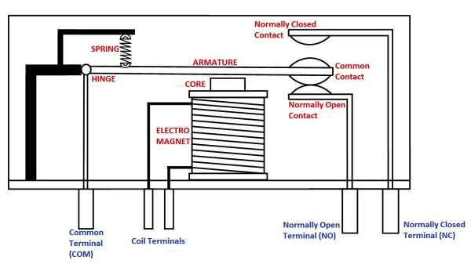
Relay Contd…
Notes:
ghyscg

Slide 50
Sensor Communication Protocol

Slide 51
Sensor Communication Protocol
Wireless sensors networks are networks of tiny, battery powered sensor nodes with limited on –board processing storage and radio capabilities.
Nodes sense and send their reports towards a processing centre which is called “sink”.
The design of protocols and applications for such network has to be energy aware in order to prolong the lifetime of the network, because the replacement of the embedded batteries is a very difficult process once these nodes have been deployed.
the regular nodes sense the field, generate the data, and send them to associated nodes. Then the after performing some processes transmit them to the BS in a multi-hop approach. Eventually the user receives the data from the BS through the Internet.

Slide 52
Sensor Communication Protocol Direct transmission protocols
Using a direct communication protocol, each sensor sends its data directly to the base station.
If the base station is far away from the nodes, direct communication will require a large amount of transmit power from each node.
This will quickly drain the battery of the nodes and reduce the system lifetime.
However, the only receptions in this protocol occur at the base station, so if either the base station is close to the nodes, or the energy required receiving data is large, this may be an acceptable method of communication.

Slide 53
Sensor Communication Protocol Clustering protocol
Nodes are organized into clusters that communicate with a local base station,
These local base stations transmit the data to the global base station, where it is accessed by the end-user.
This greatly reduces the distance nodes need to transmit their data, as typically the local base station is close to all the nodes in the cluster.
Thus, clustering appears to be an energy-efficient communication protocol.
However, the local base station is assumed to be a high-energy node; if the base station is an energy-constrained node, it would die quickly, as it is being heavily utilized.

Slide 54
Sensor Communication Protocol Radio Frequency Identification Technology
Radio-frequency identification (RFID) uses electromagnetic fields to automatically identify and track tags attached to objects.
The tags contain electronically stored information.
Passive tags collect energy from a nearby RFID reader's interrogating radio waves.
Active tags have a local power source (such as a battery) and may operate hundreds of meters from the RFID reader.
Unlike a barcode, the tag need not be within the line of sight of the reader, so it may be embedded in the tracked object.
RFID is one method for Automatic Identification and Data Capture (AIDC).

Slide 55
Sensor Communication Protocol Radio Frequency Identification Technology
RFID tags are used in many industries, for example, an RFID tag attached to an automobile during production can be used to track its progress through the assembly line
RFID-tagged pharmaceuticals can be tracked through warehouses
Implanting RFID microchips in livestock and pets allows for positive identification of animals.

